Slide 1
Computer Networks
Er. Anuj Sherchan
Electronics & Computer Department

Slide 2
Computer Network
Unit -1: Introduction to Computer Networks
Definition ,Merits and Demerits
Network Models
PAN, LAN, Campus Area Network(CAN), MAN, Country Area Network(CAN *),WAN,GAN
Topological Models(Star, Bus, Distributed Bus ,Mesh Tree, Hybrid , Ring)
Client Server ,Peer to Peer model
ISPs, NSPs Overview and Backbone of Networking
Recent Trends in Telecom Technologies

Slide 3
Computer Network
Definition, Merits and Demerits
Connection of number of computers by some communication lines.
Collection of autonomous computer interconnected by single Technology.
Interconnection can be directly or via network devices like switches and routers.

Slide 4
Computer Network
Merits
File sharing
Resource sharing
Inexpensive setup
Flexible handling
Increased storage capacity

Slide 5
Computer Network
Demerits
Security concerns
Virus and Malware
Lack of Robustness
Needs an efficient handler
Lack of independence

Slide 6
Computer Network
Uses of Computer Network
Business Applications
Home Applications
Mobile Users
Social Issues

Slide 7
Computer Network
Business Applications
Resource Sharing.
VPN(End the tyranny of geography).
IP Telephony(VOIP).
Desktop Sharing.
Electronic Commerce (E-Commerce)

Slide 8
Computer Network
Home Applications
Internet Access.
Online News.
Online Digital Library.
Entertainment and Game console .
Security Systems.

Slide 9
Computer Network
Mobile Users
Internet Access.
Global Positioning System (GPS).
Mobile Commerce (m-Commerce).
Sensor Network.
Security Systems.

Slide 10
Computer Network
Applications
Email.
Chat.
Websites.
Sharing of Documents and pictures.
Accessing centralized database for
Information.

Slide 11
Computer Network
Network Models
Personal Area Network(PAN)
Classified multiprocessor system by physical size of one Square meter.
Can also be said as “Network for One Person”.
Example:-Wireless network connecting a computer with its mouse, keyboard, and printer.

Slide 12
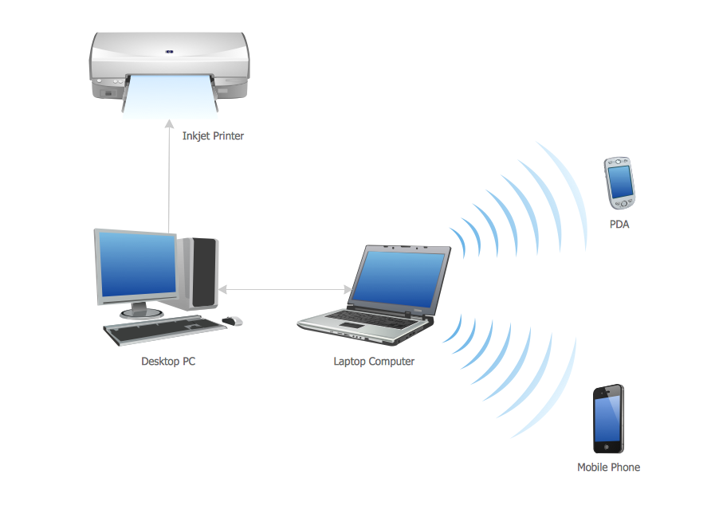
Computer Network
Personal Area Network

Slide 13
Computer Network
Network Models
Local Area Network (LAN)
Privately-owned networks within a single building or campus of up to a few kilometers in size.
Local network or a group of interconnected network that are under the same administrative control.
Interconnects local network consisting of many hundreds of hosts, installed in multiple buildings and locations.

Slide 14
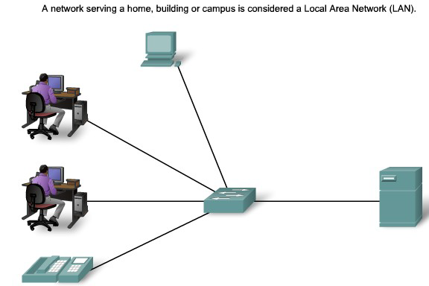
Computer Network
Local Area Network

Slide 15
Computer Network
Network Models
Campus Area Network (CAN)
Computer network that spans a limited geographic area.
CANs interconnect multiple local area networks (LAN) within an educational or corporate campus.
A campus area network is larger than a local area network since it may span multiple buildings within a specific area

Slide 16
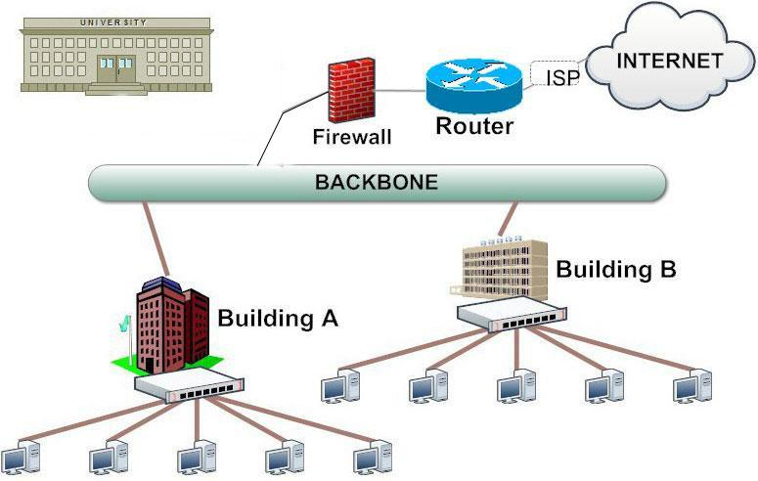
Computer Network
Campus Area Network

Slide 17
Computer Network
Network Models
Metropolitan Area Network (MAN )
A metropolitan area network(MAN) is a large computer network that usually covers a city or a large campus.
MAN usually interconnects a number of local area networks (LANs)
Uses high-capacity backbone technology, such as fiber-optical links, and provides up-link services to wide area networks (or WAN) and the Internet.

Slide 18
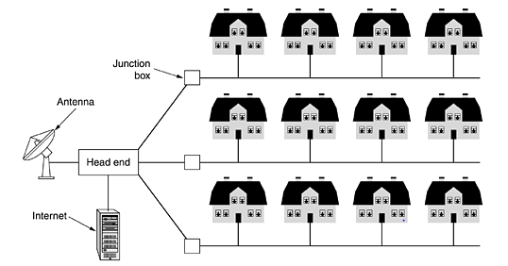
Computer Network
Metropolitan Area Network

Slide 19
Computer Network
Network Models
Wide Area Network (WAN )
Wide area network(WAN) covers broader geographical area than a local area network over public communication network.
WANs interconnect LANs, and provide access to computers or file servers in other locations.
Provide e-mail, Internet, file transfer, and e-commerce services.

Slide 20
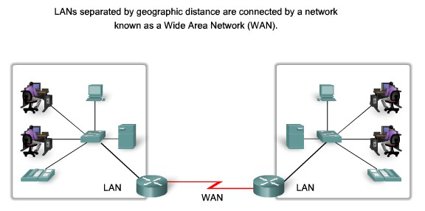
Computer Network
Wide Area Network

Slide 21
Computer Network
Topological Models
Bus Topology
A networking topology that connects system along a single cable.
Segments that are connected linearly. A network that uses a bus topology is referred to as a “bus network.”
It is easy to install and cheap in cost.
Best for the small network.

Slide 22
Computer Network
Topological Models
Ring Topology
Dedicated point to point connection between neighboring system in the shape of Ring.
Signal is passed along the ring in one direction from device to device until reaching to the destination.
Performs better than a bus topology under heavy network load.
Does not require network server to manage the connectivity between the computers.

Slide 23
Computer Network
Topological Models
Mesh Topology
In a mesh topology, every device has a dedicated point-to-point link to every other device.
The use of dedicated links guarantees that each connection can carry its own data load, thus eliminating the traffic problems that can occur when links must be shared by multiple devices.
Point-to-point links make fault identification and fault isolation easy.

Slide 24
Computer Network
Topological Models
Star Topology
Each device has a dedicated point-to-point link only to a central controller, usually called a hub (Switch).
The controller acts as an exchange: If one device wants to send data to another, it sends the data to the controller, which then relays the data to the other connected device.
The devices are not directly linked to one another.

Slide 25
Computer Network
Topological Models
Star Topology
Each device has a dedicated point-to-point link only to a central controller, usually called a hub (Switch).
The controller acts as an exchange: If one device wants to send data to another, it sends the data to the controller, which then relays the data to the other connected device.
The devices are not directly linked to one another.

Slide 26
Computer Network
Network Architecture
We classify Network Architecture in two types.
a. Peer to Peer Model.
b. Client-Server Model.
c. Active Network Model

Slide 27
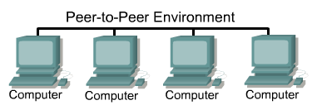
Computer Network
Peer to Peer Model
In peer to peer network, computer in network acts as a equal partner.
Individual System control their own Resources.

Slide 28
Computer Network
Peer to Peer Model
Individual System makes it own decision.
No Central point administration and control.
Works well for small network.
Each PC can make backup copies of its data to other PCs for security.
Simple network: Perfect for home and Office.
.

Slide 29
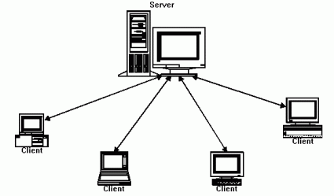
Computer Network
Client Server Model

Slide 30
Computer Network
Client Server Model
The term client-server refers to a popular model for computer networking that utilizes client and server devices each designed for specific purposes.
In a client/server arrangement, network services are located on a dedicated computer called a server.

Slide 31
Computer Network
Client Server Model
Server is a central computer that is continuously available to respond to requests from clients for file, print, application, and other services.
Servers are with additional processing power, memory, and specialized software function.
Clients access the server resources, after being identified authorized.

Slide 32
Computer Network
Advantages of Client Server Model
Provides flexibility of System.
Decreases Cost.
Centralized Control.
Improved Network.
Optimum Resource Utilization.

Slide 33
Computer Network
ISPs, NSPs Overview and Backbone of Networking
A Network Service Provider (NSP) is a business entity that provides or sells services such as network access and bandwidth by allowing access into its backbone infrastructure or access to its network access points (NAP), which consequently also means access to the Internet.
NSPs are very similar to or can even be considered the same as ISPs, but in most cases, they are the ones providing backbone services to ISPs.
Some of the world's top NSPs include companies like AT&T Inc., CenturyLink, China Telecom, Deutsche Telekom, and Verizon Business.

Slide 34
Computer Network
ISPs, NSPs Overview and Backbone of Networking
Internet Service Providers (ISPs) are organizations that provide internet services to end customers and businesses.
ISPs purchase wholesale bandwidth from NSPs, which provides connectivity for their customers. Customers then access the network through their ISP's last-mile infrastructure, which, in turn, connects to the NSP's backbone.
Word link, Vianet are the ISPs in Nepal.

Slide 35
Computer Network
ISPs, NSPs Overview and Backbone of Networking
The internet backbone consists of large network providers called NSPs.
These larger networks supply backbone access to regional and local ISPs to which everyone else connects.
NSPs essentially provide the infrastructure that makes up the internet.
NSPs communicate with each other via Network Access Points (NAP) or Metropolitan Area Exchanges (MAE), which are similar to NAPs but privately owned.

Slide 36
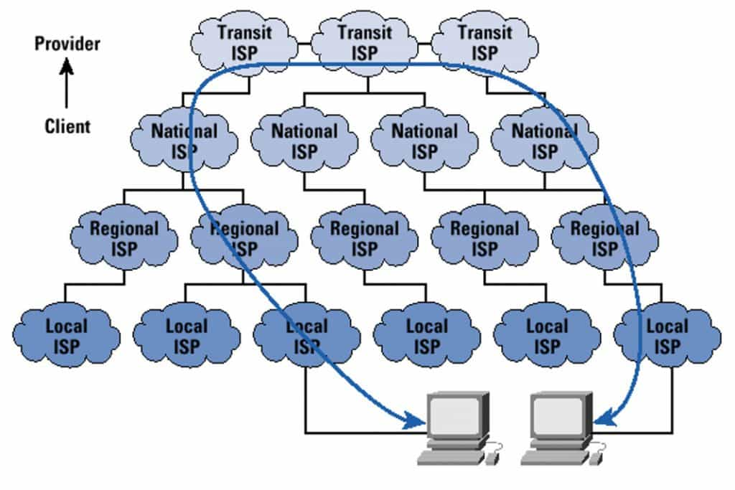
Computer Network
ISPs, NSPs Overview and Backbone of Networking

Slide 37
Computer Network
Recent Trends in Telecom Technologies
1st Generation(1G):
First-generation mobile networks relied on analogue radio systems, which meant that users could only make phone calls and not send or receive text messages.
The 1G network was first introduced in Japan in 1979 before being rolled out in other countries, such as the USA, in 1980.
Cell towers were built around the country to make it work, meaning that signal coverage could be obtained from greater distances.
However, the network was unreliable and had some security issues.
For instance, cell coverage would often drop, it would experience interference by other radio signals, and it could easily be hacked due to a lack of encryption.

Slide 38
Computer Network
Recent Trends in Telecom Technologies
2nd Generation(2G):
The 1G network was not perfect, but it remained until 1991, when it was replaced with 2G.
This new mobile network ran on digital signal, not analogue, vastly improving its security and capacity.
On 2G, users could send SMS and MMS messages (although slowly and often without success), and when GPRS was introduced in 1997, users could receive and send emails on the move.

Slide 39
Computer Network
Recent Trends in Telecom Technologies
3rd Generation(3G):
Third-generation mobile networks are still in use, but normally, when the superior 4G signal fails.
3G revolutionized mobile connectivity and the capabilities of cell phones. Compared to 2G, 3G was much faster and could transmit greater amounts of data.
This means that users could video call, share files, surf the internet, watch TV online, and play games on their mobiles for the first time.
Under 3G, cell phones were no longer just about calling and texting; they were the hub of social connectivity.

Slide 40
Computer Network
Recent Trends in Telecom Technologies
4th Generation(4G):
The introduction of 4G went one step further than the revolutionary 3G.
It is five times faster than the 3G network – and can theoretically provide speeds of up to 100Mbps.
All mobile models released from 2013 onwards should support this network, which can offer connectivity for tablets, laptops, and smartphones.
Under 4G, users can experience better latency (less buffering), higher voice quality, easy access to instant messaging services and social media, quality streaming, and faster downloads.

Slide 41
Computer Network
Recent Trends in Telecom Technologies
5th Generation(5G):
The network has arrived and has been largely welcomed by the mobile industry.
The network has changed more than our mobile use and affects how we connect our devices to the internet.
The improved speed and the massive network capacity have developed new IoT trends, such as smart cities, healthcare, IoT in the home or office and connected cars.
5G can theoretically have a download speed 20x faster than 4G and boasts a very low latency compared to its predecessor. This means the time delay for online gaming, video calls, and critical mission applications will be significantly lower.

Slide 42
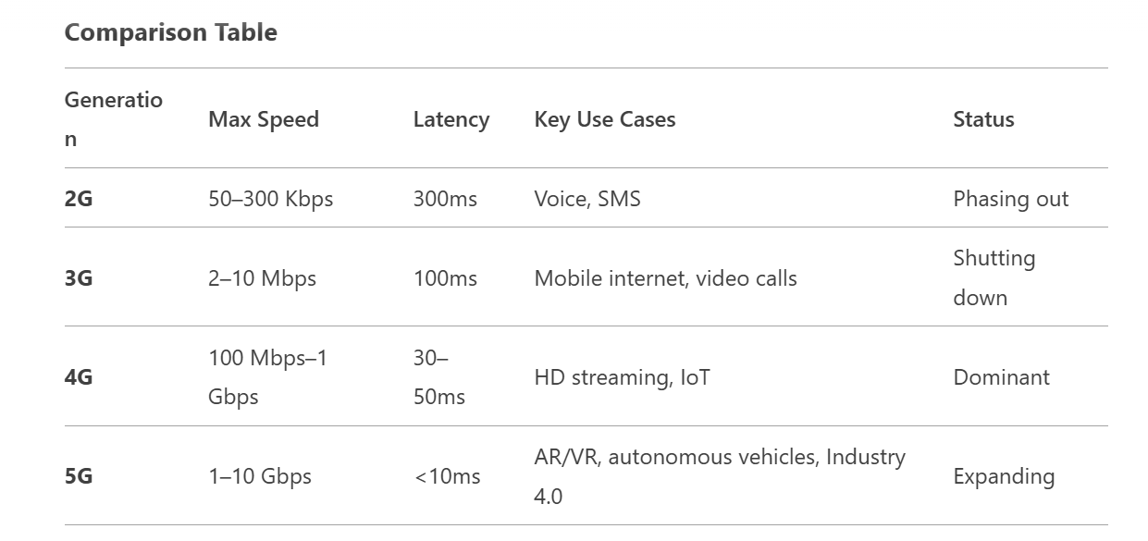
Computer Network
Recent Trends in Telecom Technologies

Slide 43
Computer Network
Recent Trends in Telecom Technologies
Future Outlook
5G will dominate through 2030, with 6G expected by 2030+.
AI/ML integration for smarter network management.
Satellite 5G (e.g., Starlink + T-Mobile) for global coverage.
Green telecom initiatives to reduce energy consumption.

Slide 44
End of Unit 1
THANK YOU !!!

